Slide 1


Tech Talks
Frameworks Won't Save Your Bad Practices!
How to avoid bad coding habits, poor architecture, and weak security.

Slide 2
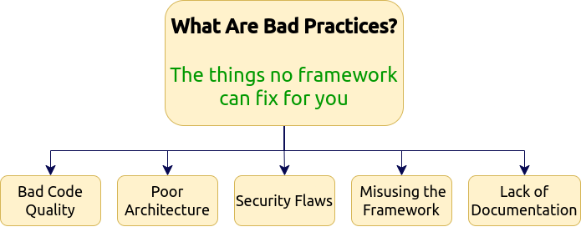



Slide 3


Slide 4
Code that is hard to read, understand, maintain. It often lacks proper structure, meaningful names, or clear logic, and tends to be duplicated, messy, or overly complex. Bad code "works" but makes future changes risky and costly.
CAN’T BE READABLE MAINTAINABLE SCALABLE REUSABLE

Slide 5
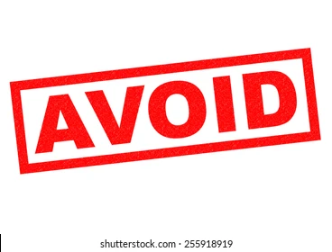
We
Should
Write
Clean Code

Slide 6

Clean Code is
Code that is hard to read, understand, maintain. It often lacks proper structure, meaningful names, or clear logic, and tends to be duplicated, messy, or overly complex. Bad code "works" but makes future changes risky and costly.
CAN BE READABLE MAINTAINABLE SCALABLE REUSABLE

Slide 7


Interfaces
vs
Abstract Classes

Slide 8
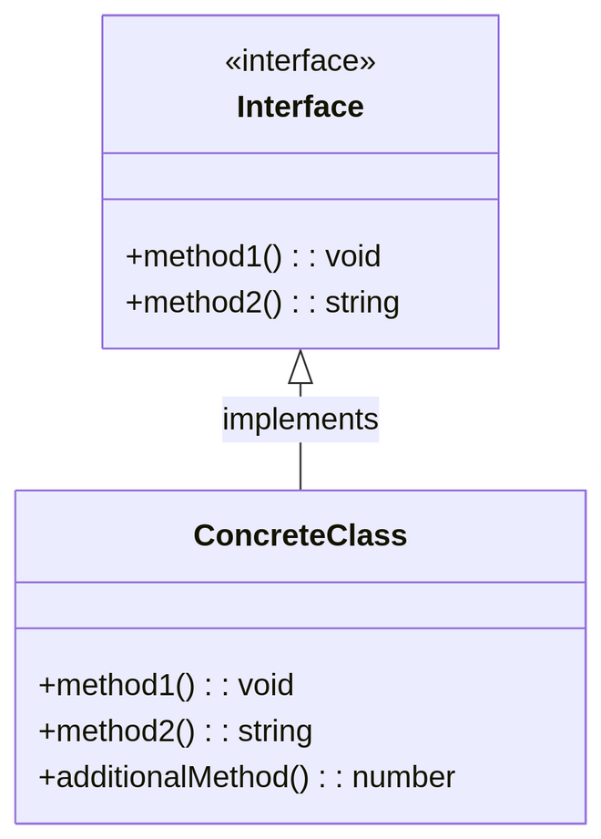
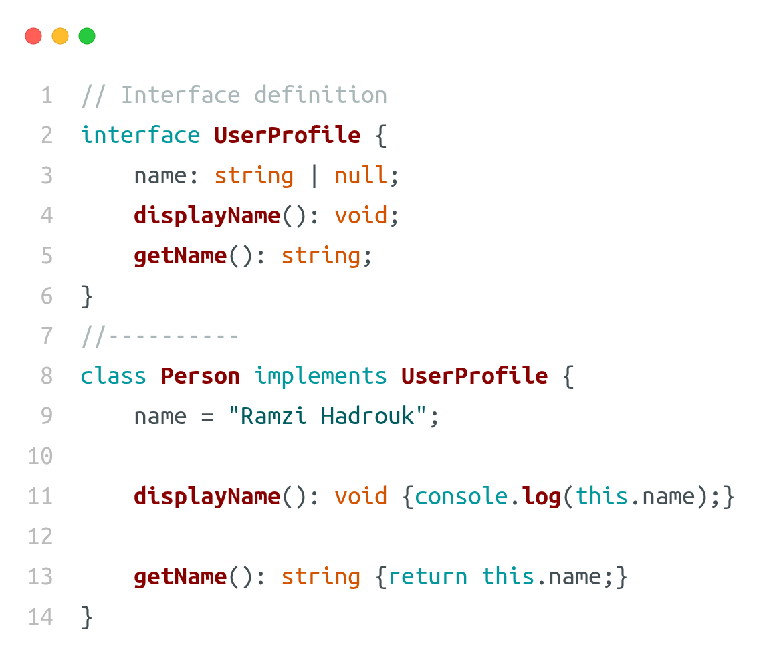
Interface
an interface is a set of rules that tells a class or object what properties and functions it must have. It doesn’t include the actual code just the names and types

Slide 9
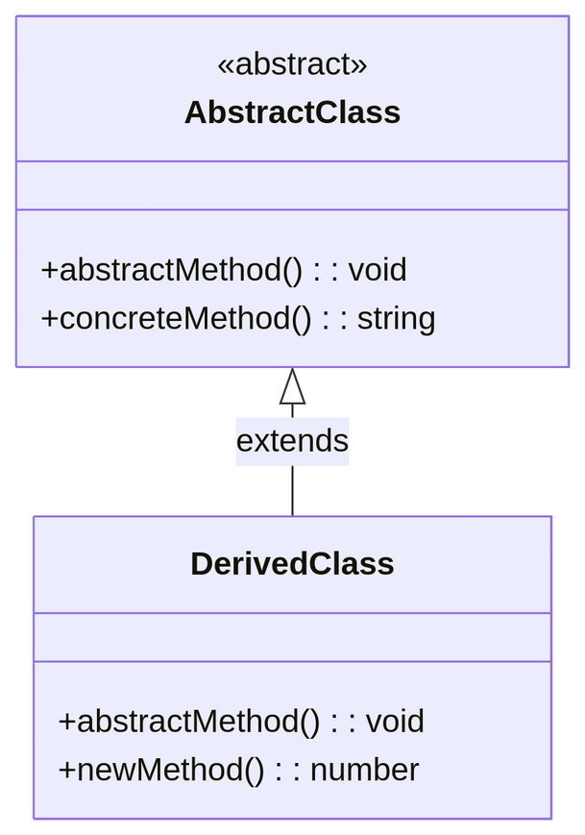
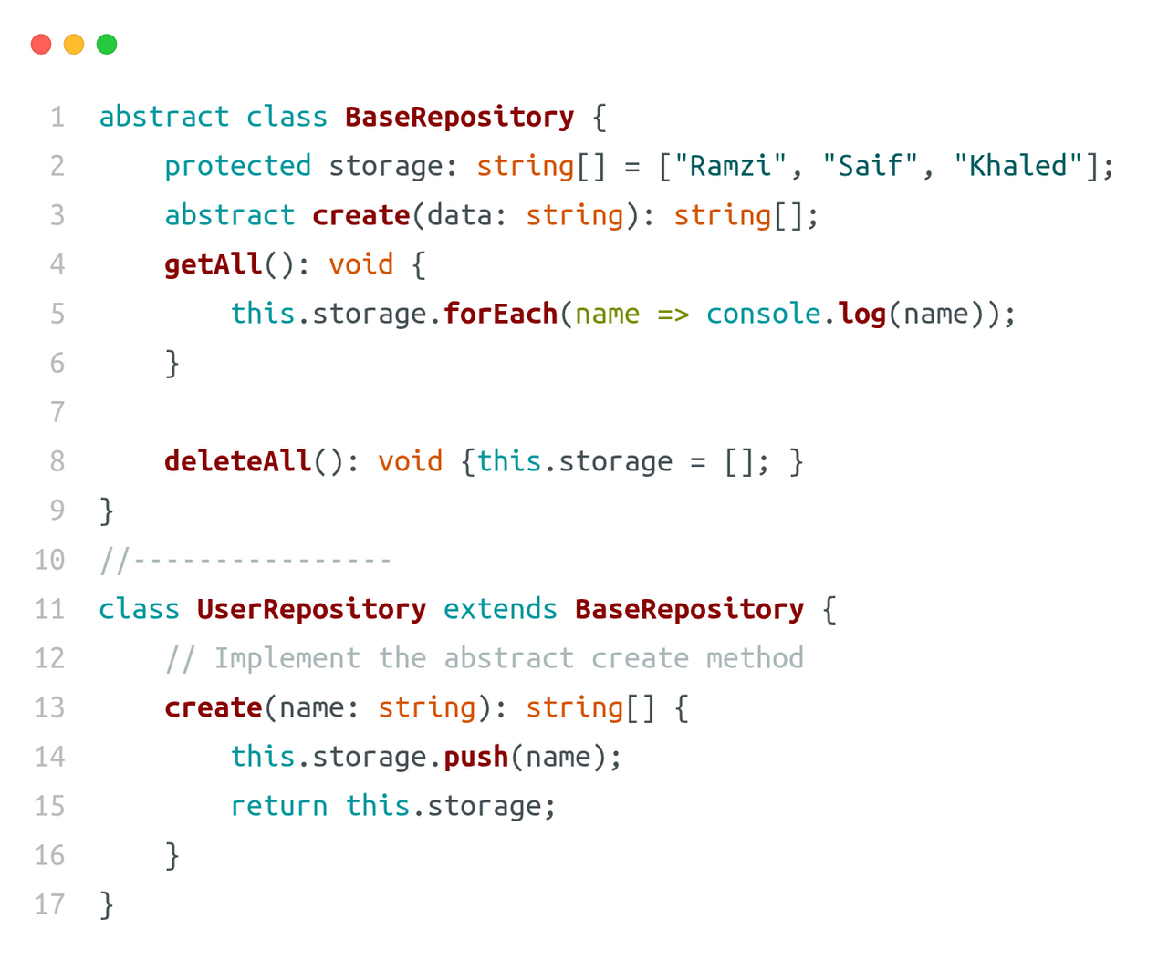
abstract
An abstract class defines a common structure and behavior, including some methods that must be implemented by subclasses and others that are already implemented and can be used or overridden.

Slide 10
What We Should Do To Get
CLEAN CODE?

Slide 11
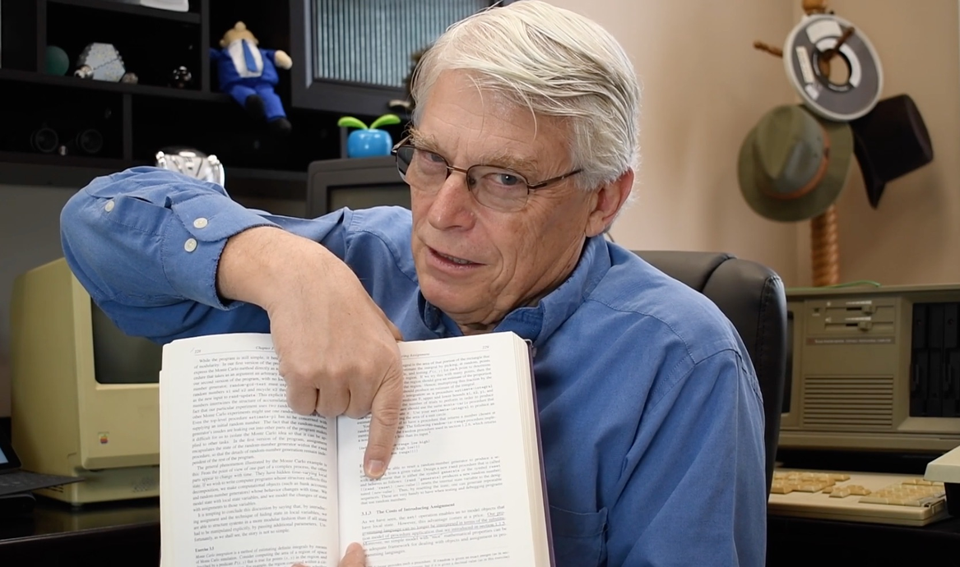
SOLID
principles
Robert c Martin

Slide 12
SOLID
S – Single Responsibility Principle (SRP)
O – Open/Closed Principle (OCP)
L – Liskov Substitution Principle (LSP)
I – Interface Segregation Principle (ISP)
D – Dependency Inversion Principle (DIP)

Slide 13
SOLID
S – Single Responsibility Principle (SRP)
Each class /function should do one thing only.
=
responsible for one task.

Slide 14
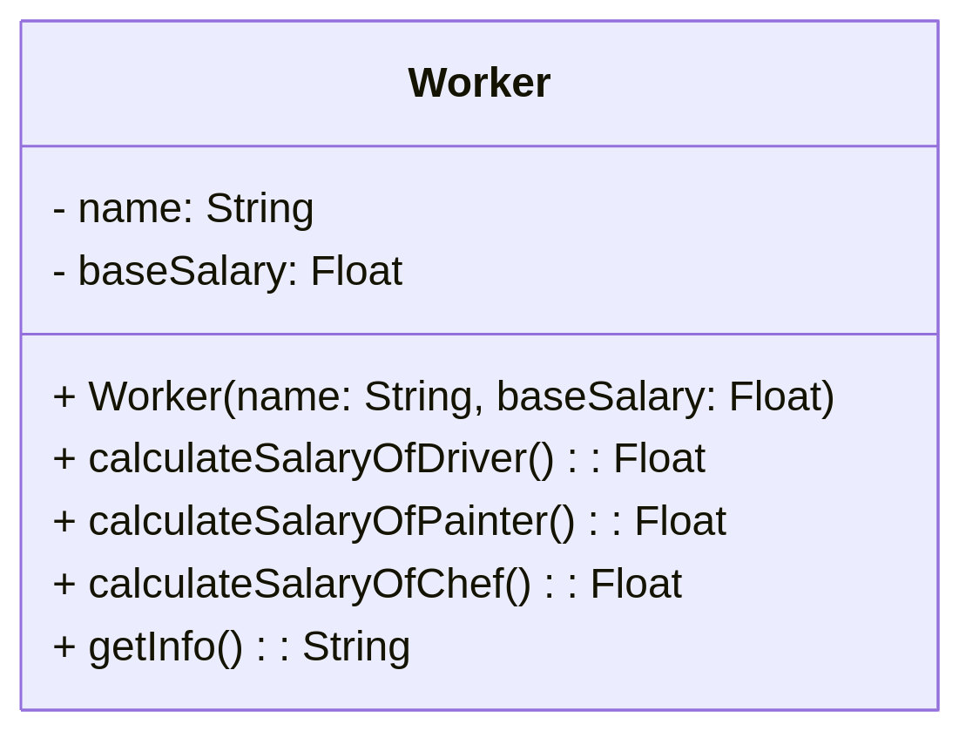
SOLID
S – Single Responsibility Principle (SRP)

Slide 15
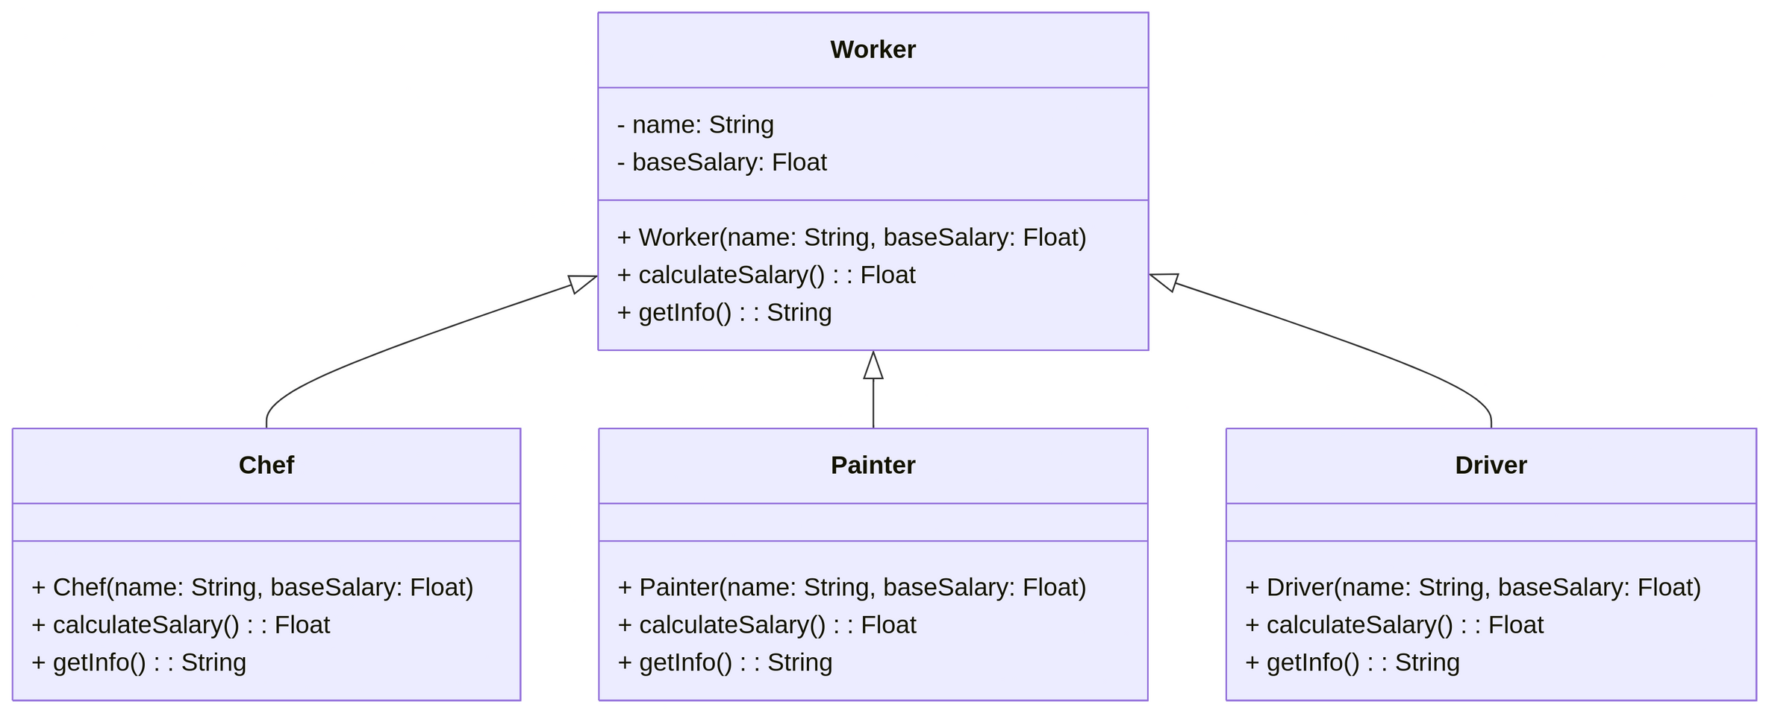
SOLID
S – Single Responsibility Principle (SRP)

Slide 16
SOLID
O – Open/Closed Principle (OCP)
(classes, functions, and so on) should be open for extension, but closed for modification.

Slide 17
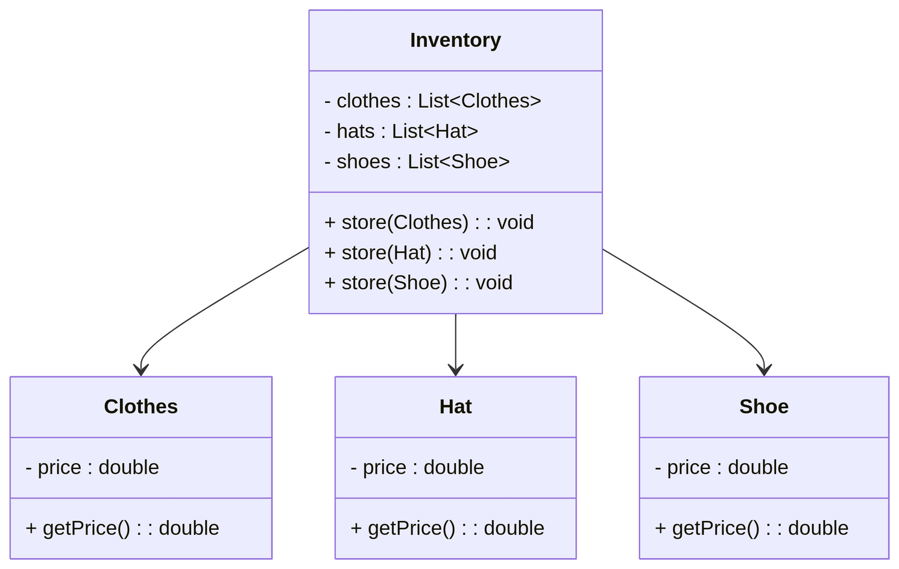
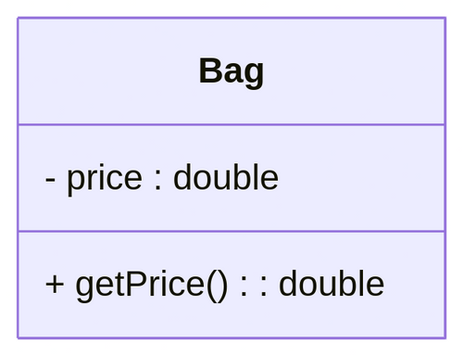
SOLID
O – Open/Closed Principle (OCP)
suppose we have to add Bag class what are the steps
1
+store(Bag)
2

Slide 18

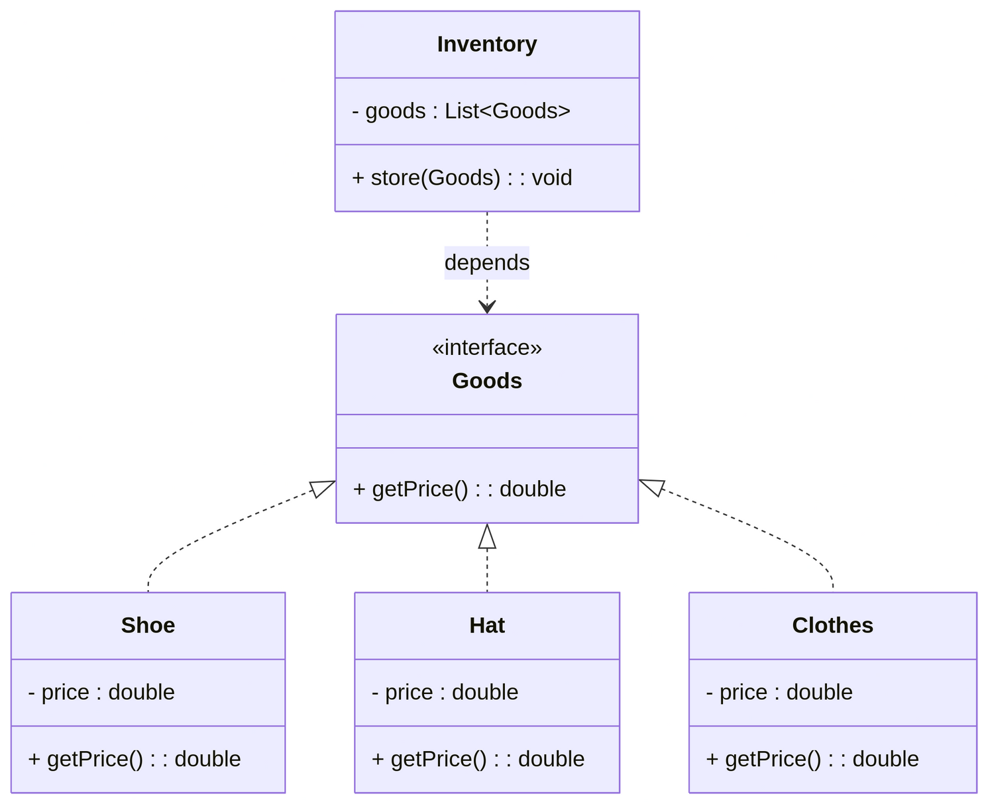
SOLID
O – Open/Closed Principle (OCP)
1
Done !!

Slide 19
SOLID
L – Liskov Substitution Principle (LSP)
objects of a superclass should be able to be replaced with objects of a subclass without affecting the correctness of the program.

Slide 20
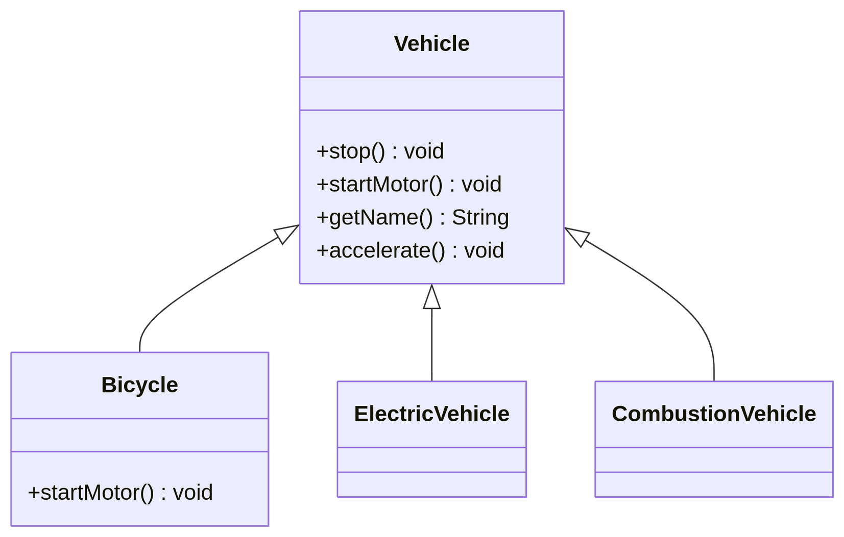
SOLID
L – Liskov Substitution Principle (LSP)

Slide 21
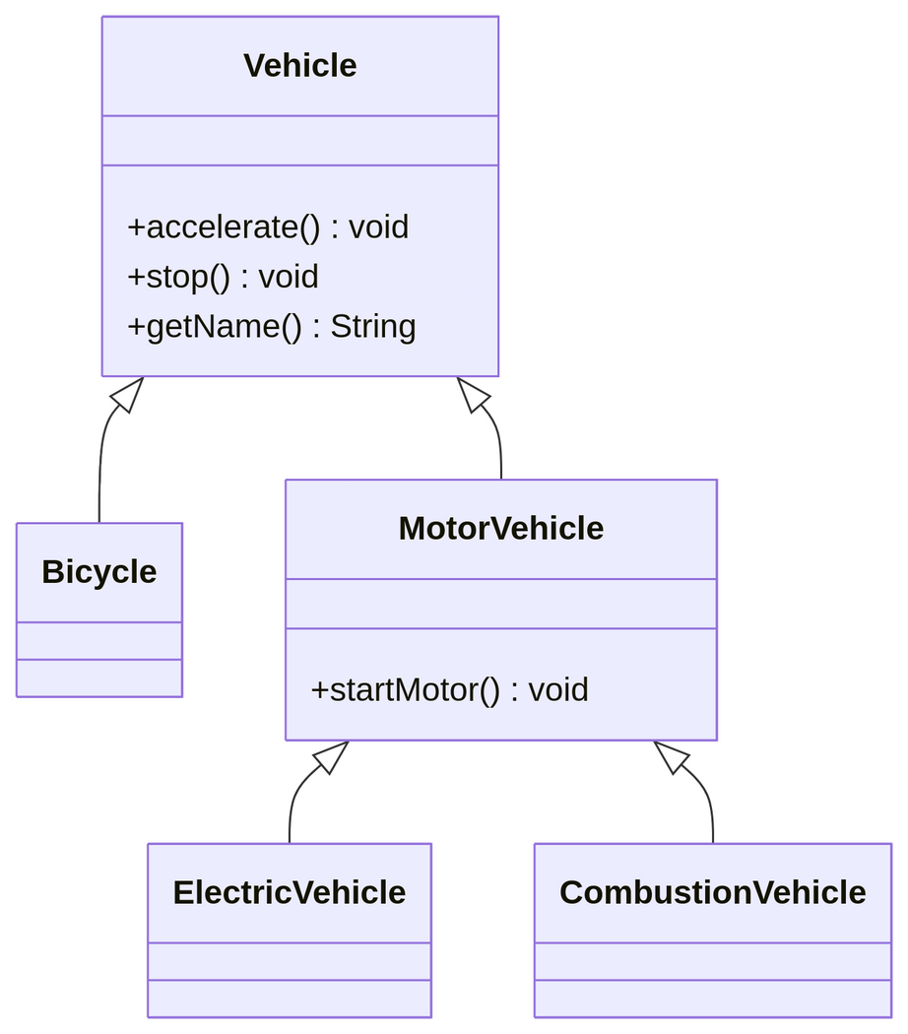
SOLID
L – Liskov Substitution Principle (LSP)

Slide 22
SOLID
I – Interface Segregation Principle (ISP)
Clients should not be forced to depend on interfaces they don’t use.

Slide 23
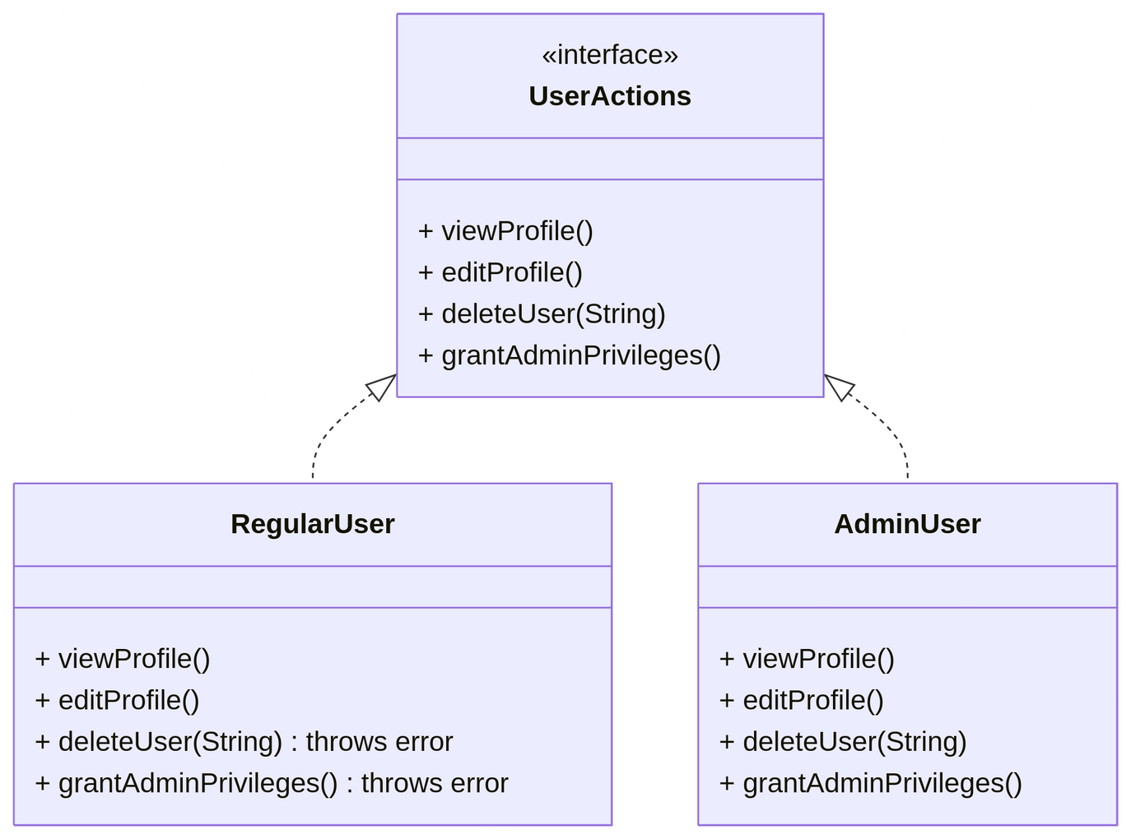
SOLID
I – Interface Segregation Principle (ISP)

Slide 24
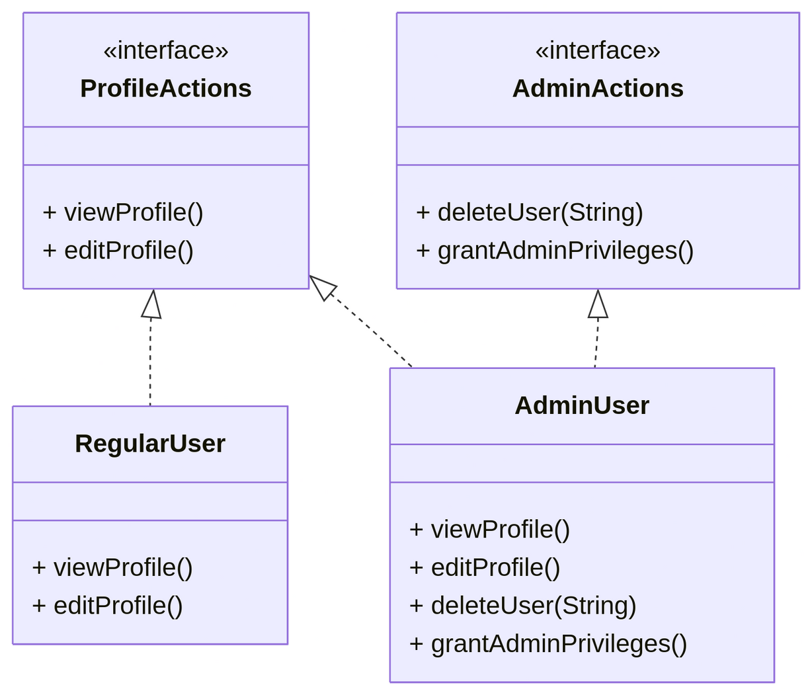
SOLID
I – Interface Segregation Principle (ISP)

Slide 25
SOLID
D – Dependency Inversion Principle (DIP)
High-level modules should not depend on the low-level modules. Both should depend on abstractions.

Slide 26
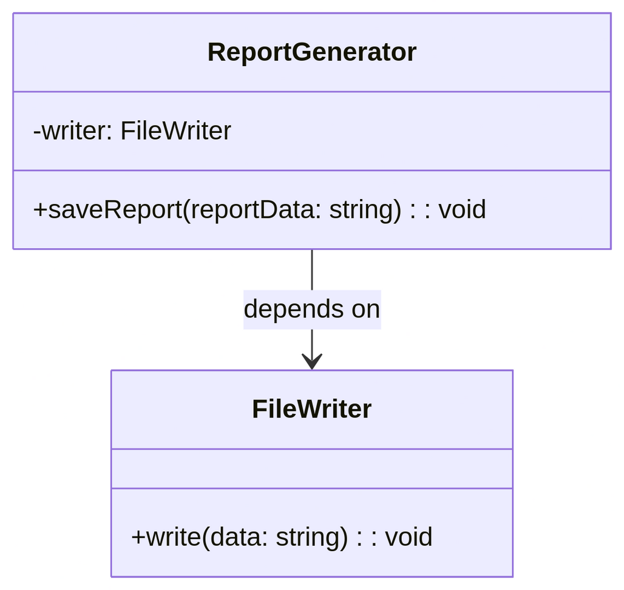
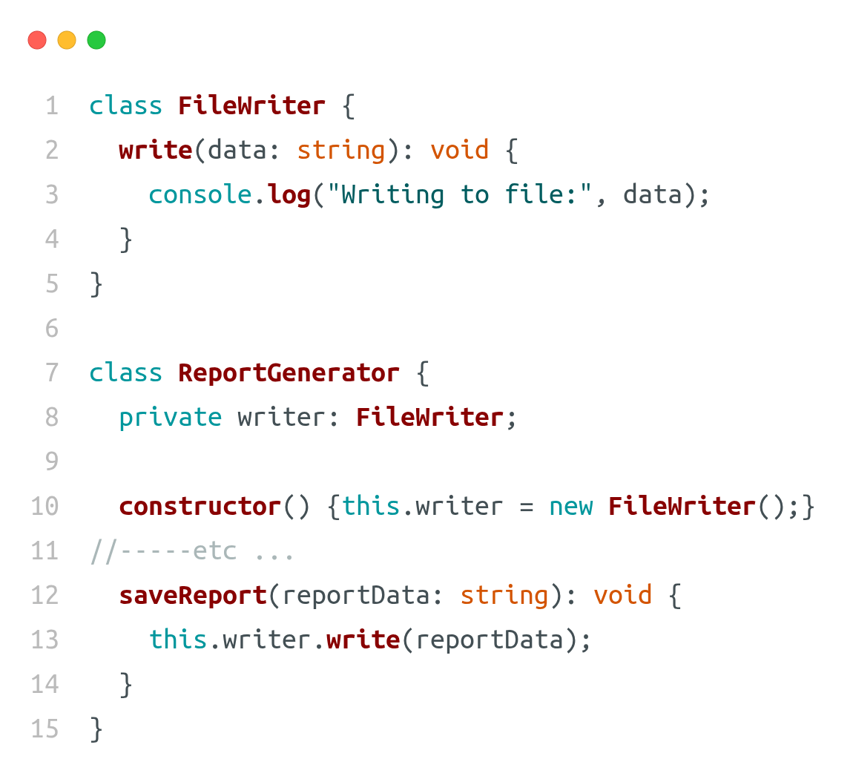
SOLID
D – Dependency Inversion Principle (DIP)

Slide 27
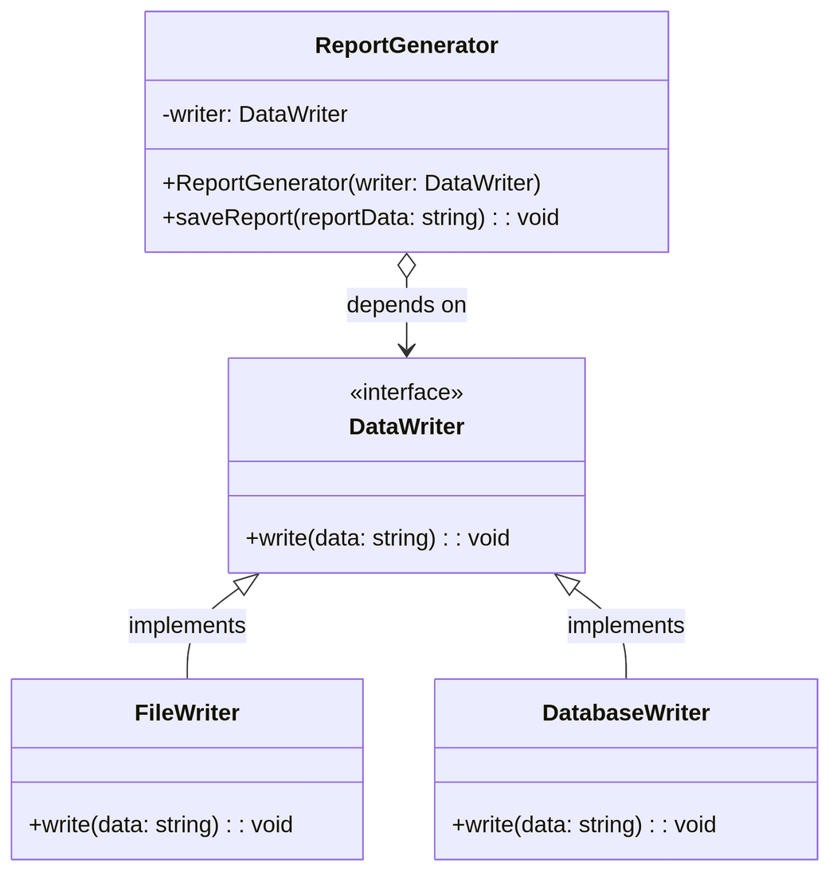
SOLID
D – Dependency Inversion Principle (DIP)
In many cases in OOP, applying the Dependency Inversion Principle leads to adherence to the Open/Closed Principle .

Slide 28


